Slide 1
F4PGA: Open Source Toolchain, Interchange
Format and More in New CHIPS Alliance Workgroup
CHIPS Spring Workshop 2022, 2022-04-19
Karol Gugala, kgugala@antmicro.com
Michael Gielda, mgielda@antmicro.com

Slide 2


F4PGA: Open Source Toolchain, Interchange Format and More
ANTMICRO
Founded in 2009, Antmicro provides commercial engineering services, open source platforms, tools and strategic R&D for high-tech products
Introducing new design methodologies and workflows based on open source
Comprehensive, end-to-end custom hardware and product development services

Slide 3
F4PGA: Open Source Toolchain, Interchange Format and More
SCALING WITH OPEN SOURCE
We provide open source services to hyperscalers and large corporations, introducing new workflows and design methodologies based on open source
We help customers reap the benefits of next-gen platforms and open source: vertical integration, full control, portability, rapid iteration
We believe hardware developers can and should get the benefits of collaboration that open source software developers have!

Slide 4
F4PGA: Open Source Toolchain, Interchange Format and More
CHIPS ALLIANCE
CHIPS Alliance’s breadth covers many of our focus areas: with our CHIPS partners and customers we work with development of open source cores, IP blocks and tools for RISC-V-based SoCs - cores and peripherals
As a Platinum Member we lead several tooling efforts, including the creation of the F4PGA Workgroup and the related development

Slide 5


F4PGA: Open Source Toolchain, Interchange Format and More
CHIPS ALLIANCE WORKGROUPS
F4PGA
Interconnects
Chisel
Cores
Rocket
RISC-V DV
Tools
Analog

Slide 6
F4PGA: Open Source Toolchain, Interchange Format and More
THE F4PGA WORKGROUP
Established by CHIPS Alliance based on previous work known as SymbiFlow
F4PGA = FOSS Flow For FPGA
Goal: drive open source tooling, IP and research efforts for FPGAs
Groups academia members, industry and FPGA vendors
Focus on:
Open source toolchain for FPGAs (previously known as SymbiFlow)
FPGA Interchange Format
FPGA Perf Tool
Many more…

Slide 7

F4PGA: Open Source Toolchain, Interchange Format and More
REPRESENTING MANY PERSPECTIVES
Academia
research of new place and route algorithms, novel design approaches
organize internships, teach classes, extend toolchain in new directions
Industry
provide real use cases and requirements
improve robustness and reliability of toolchain
FPGA vendors
collaborate in building out ecosystem
reach end users
information, joint roadmaps and planning

Slide 8








F4PGA: Open Source Toolchain, Interchange Format and More
CURRENT MEMBERS

Slide 9
F4PGA: Open Source Toolchain, Interchange Format and More
F4PGA OPEN TOOLCHAIN
Fully open source toolchain for FPGA development
Aims to provide an end-to-end FPGA flow, vendor-neutral
Makes FPGA development software-centric and collaborative
Vital for research, prototyping, niche uses - toolchain openness allows adaptations for various cases
With open tools, we’re hoping FPGAs can become “mundane” part of future SoCs
Now part of CHIPS Alliance
https://f4pga.org/

Slide 10
F4PGA: Open Source Toolchain, Interchange Format and More
F4PGA OPEN TOOLCHAIN
ENABLING DEVELOPMENT FOR EVERYONE
Currently supported architectures:
Xilinx 7-Series,
QuickLogic EOS S3,
Lattice CrossLink NX,
Lattice iCE40,
Lattice ECP5 FPGAs,
More to come...

Slide 11
F4PGA: Open Source Toolchain, Interchange Format and More
F4PGA OPEN TOOLCHAIN

Slide 12
F4PGA: Open Source Toolchain, Interchange Format and More
FPGA INTERCHANGE FORMAT
Common format for describing FPGA architecture
Bridging open and proprietary FPGA tools for easier interop
Lowers barriers to developing new open source tools and new approaches to partial dynamic reconfiguration, exploration of different place & route algorithms, etc.
Developed in collaboration between Antmicro, Google and Xilinx (now AMD)

Slide 13
F4PGA: Open Source Toolchain, Interchange Format and More
FPGA INTERCHANGE FORMAT
SPECIFICATION
The format is described via a set of schemas defined using the Cap'n'Proto library schema language.
The library was chosen as it allows for generating consistent data access API while supporting multiple programming languages and being cross-platform.
All the schemas are available in the GitHub repository: https://github.com/chipsalliance/fpga-interchange-schema

Slide 14
F4PGA: Open Source Toolchain, Interchange Format and More
FPGA INTERCHANGE FORMAT
SPECIFICATION
struct PhysNetlist {
part @0 : Text;
placements @1 : List(CellPlacement);
physNets @2 : List(PhysNet);
physCells @3 : List(PhysCell);
strList @4 : List(Text) $hashSet();
siteInsts @5 : List(SiteInstance);
properties @6 : List(Property);
nullNet @7 : PhysNet;
struct PinMapping {
cellPin @0 : StringIdx $stringRef();
bel @1 : StringIdx $stringRef();
belPin @2 : StringIdx $stringRef();
isFixed @3 : Bool;
union {
multi @4 : Void;
otherCell @5 : MultiCellPinMapping;
}
}
struct MultiCellPinMapping {
multiCell @0 : StringIdx $stringRef();
multiType @1 : StringIdx $stringRef();
}
Define various aspects of the data used by FPGA toolchain
Device resources
Logical netlist - a synthesized design
Physical netlist - placed and routed designs
Each step is “interchangeable” between tools supporting the format

Slide 15
F4PGA: Open Source Toolchain, Interchange Format and More
FPGA INTERCHANGE FORMAT ADOPTION AND PLANS
Adoption
Xilinx RapidWright
nextpnr
Q2
VPR/VTR
Yosys
Read more
Blog by Xilinx (AMD)
Blog by Google/Antmicro

Slide 16
F4PGA: Open Source Toolchain, Interchange Format and More
FPGA PERF TOOL
Tool by Antmicro to analyzes various FPGA tools for Synthesis and Place & Route (both open source and proprietary)
Measures tool performance (MHz, resources, runtime, etc), runtime and quality of results
Tells you how well your design is faring over time to detect regressions
Repository
Dashboard

Slide 17
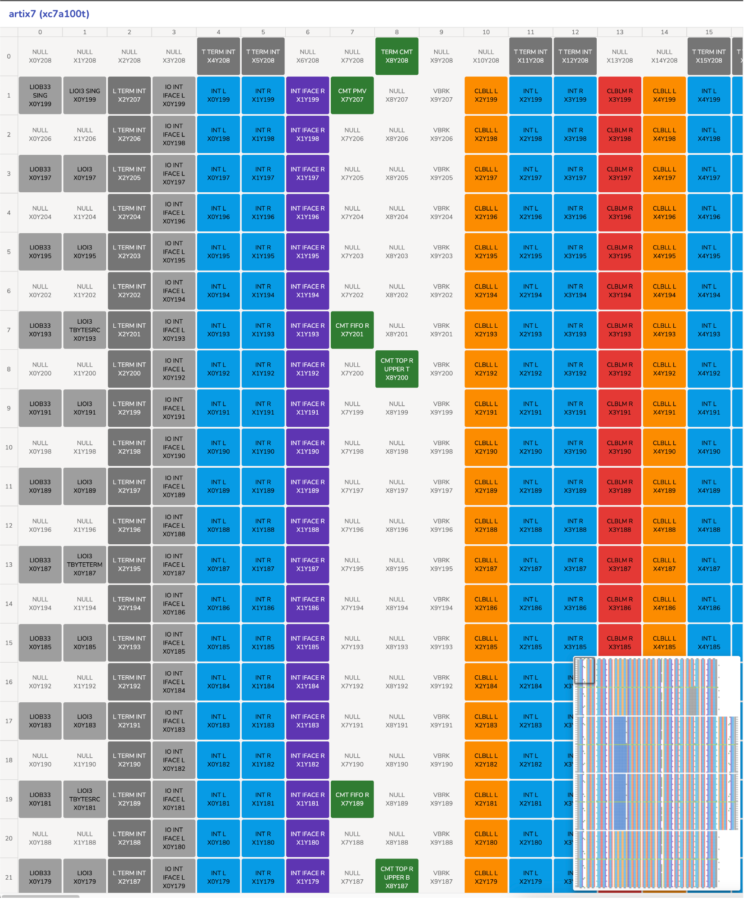
F4PGA: Open Source Toolchain, Interchange Format and More
FPGA DATABASE VISUALIZER
Interactively visualize the F4PGA databases
Learn more about the FPGA’s internal structure to devise more efficient ways to program them
Generated by a library allowing you to visualize arbitrary tile-based FPGAs

Slide 18

F4PGA: Open Source Toolchain, Interchange Format and More
MORE F4PGA PROJECTS
FPGA Assembly Parser and Generation Library (FASM)
Yosys F4PGA plugins
many more helper tools and repositories

Slide 19
F4PGA: Open Source Toolchain, Interchange Format and More
SUMMARY
CHIPS Alliance is building an open source hardware ecosystem (FPGA & ASIC)
The Interchange Format shows that collaboration between many entities - including FPGA vendors - is not only possible but a necessity
We would want to “transplant” this success also to ASIC domain - interoperability formats are great!
Practical use cases of F4PGA are possible already now (vendor tooling, IP, research)
Enabling rapid prototyping and software-driven development of FPGA-based systems in areas such as ML and video processing

Slide 20

F4PGA: Open Source Toolchain, Interchange Format and More
JOIN US
Join the F4PGA Workgroup mailing list!
#f4pga channel on the CHIPS Alliance Slack (bridged with IRC #f4pga channel)
Join CHIPS Slack workspace
Follow us on Twitter
Check the code on GitHub

Slide 21
THANK YOU
FOR YOUR ATTENTION!

